Slide 1
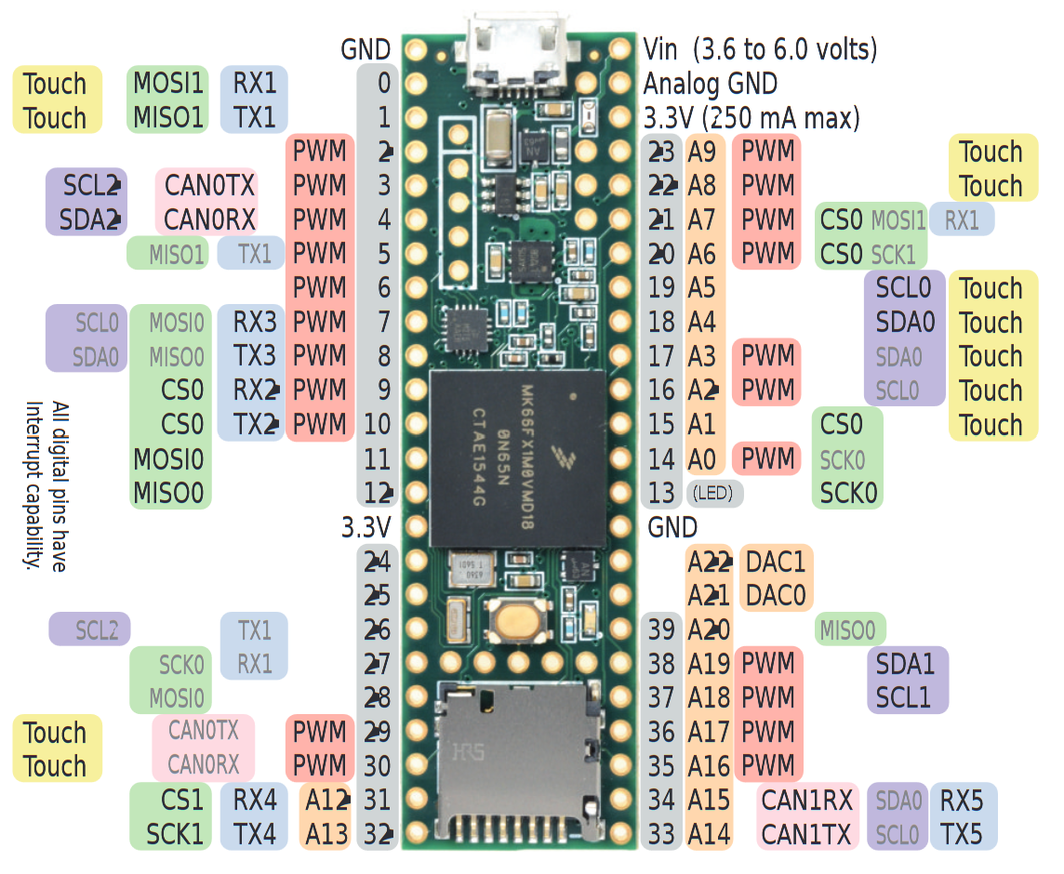
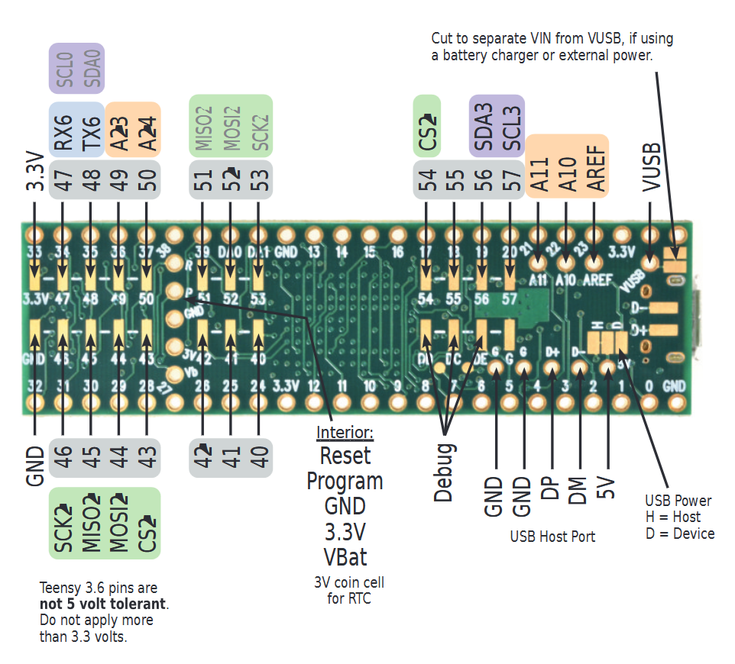
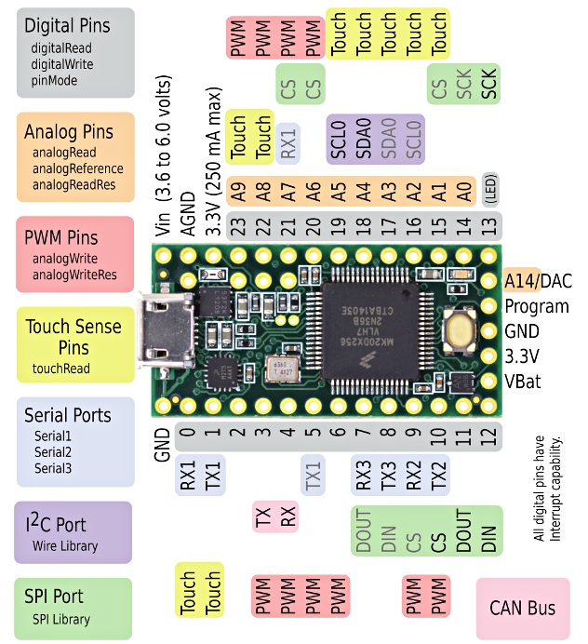
Teensy 3.6

Slide 2
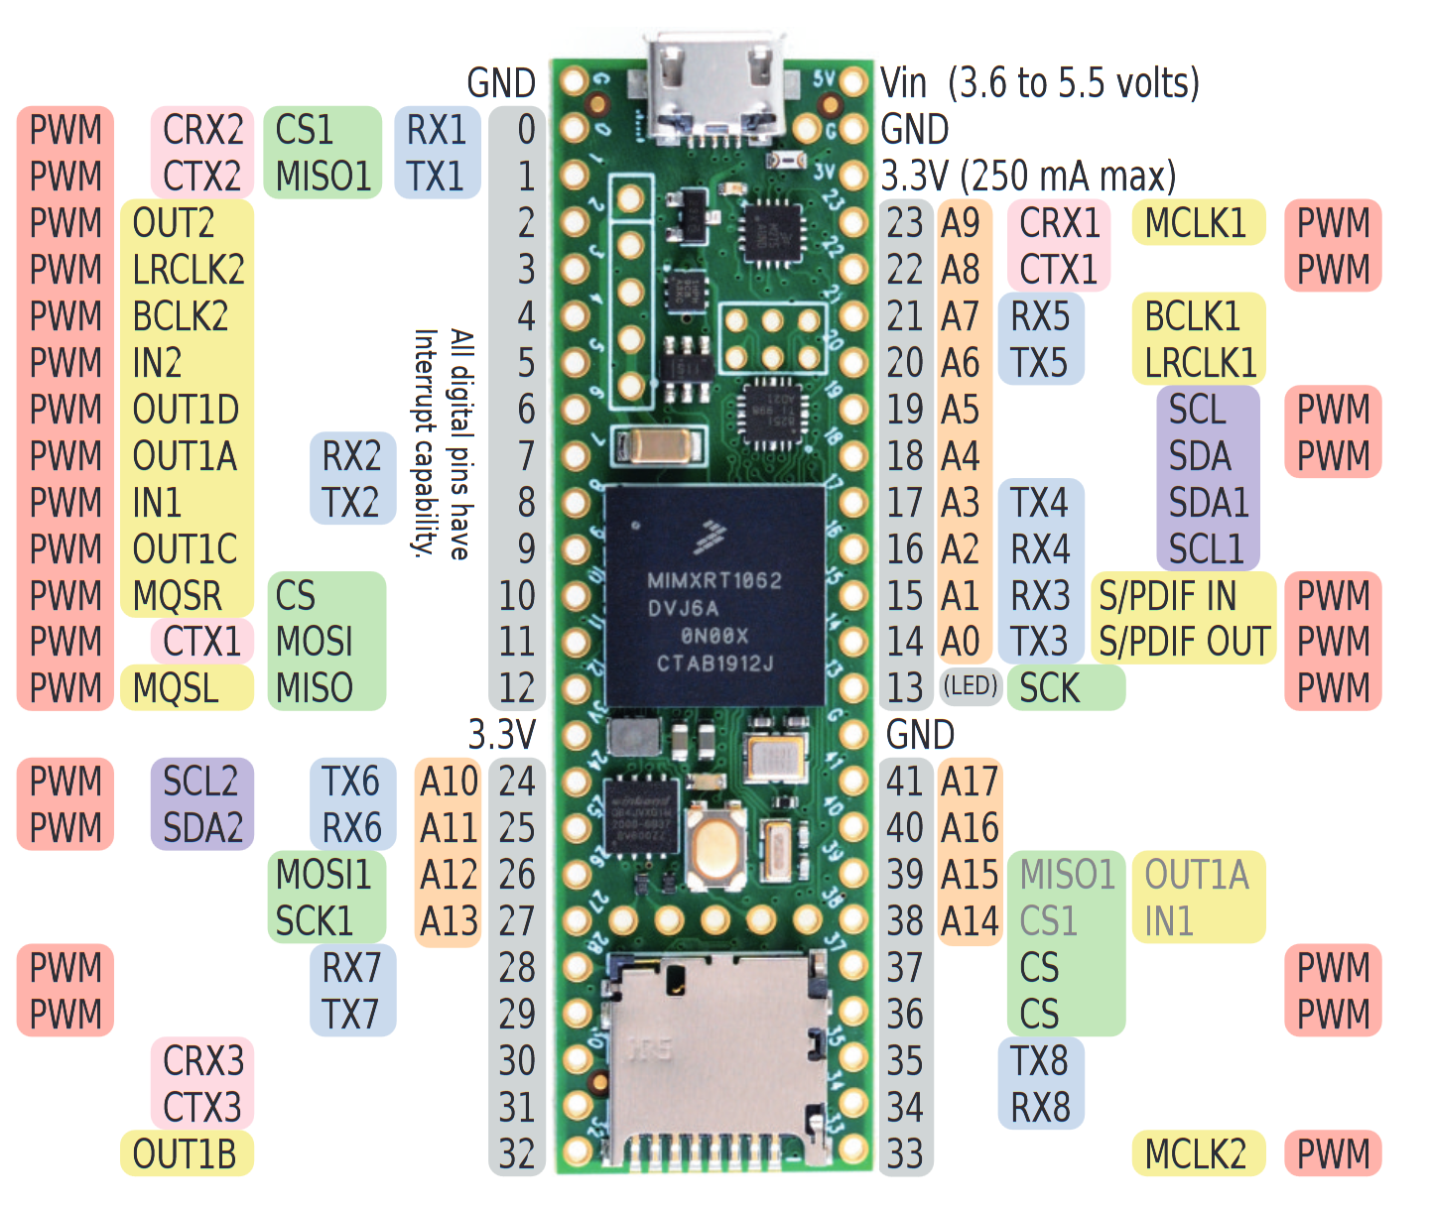
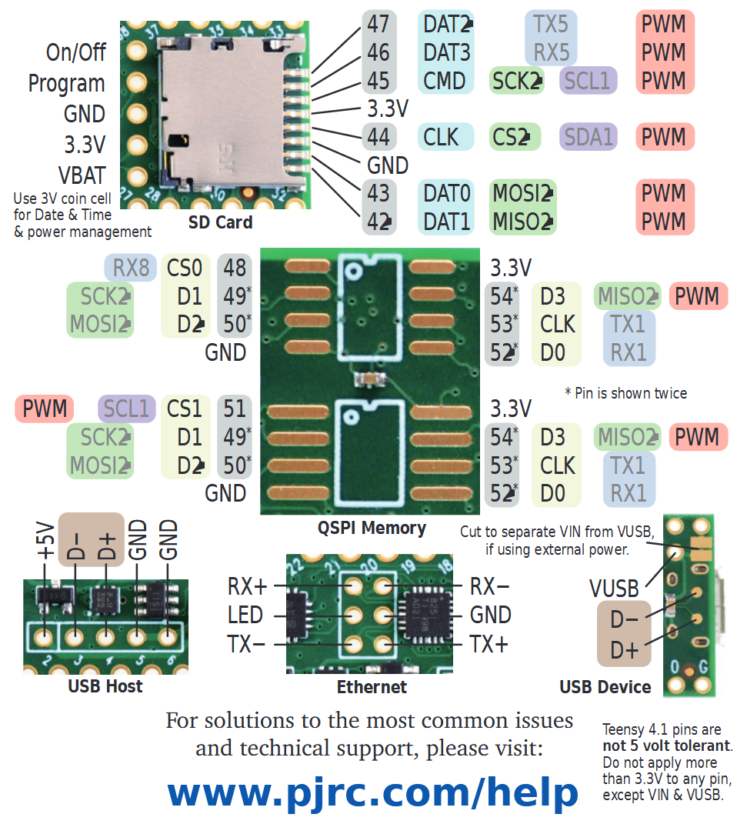
Teensy 4.1

Slide 3
REV 1 – breadboard current in 971
Ground connections are generally implied
Valve box
Teensy 3.6
To PC
Transistor array
(ULN2003)
Control box
Valves
RJ45
RJ45
* Also has LEDS
Olfactometer communication status LED
CPAP Pin
ThorLabs powermeter analog in (BNC)
CPAP valve
Power
+3.3v
GND
RJ45
Potentiometer controls threshold for respiratory phase specific stimulation (defined as POT_PIN in cobalt-control)
Audio
Camera pulser
(teensy x.x)
RJ45
Record
(Nidq digital)
(teensy x.x)
Olfactometer
To nidq digital
Chameleon
Laser (BNC)

Slide 4
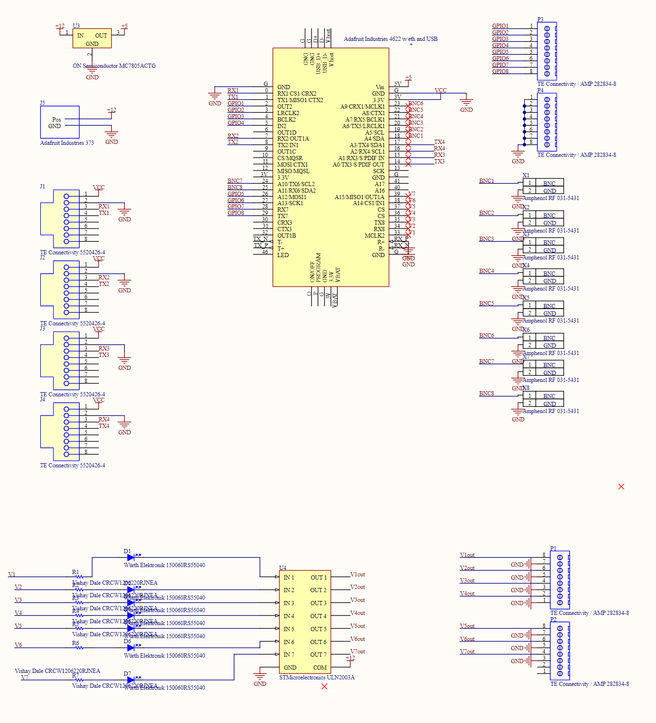
REV 2– PCB designed in circuitmaker and printed.
Teensy 4.1
GPIO pins
Power
Grounds
Missing: a potentiometer for thresholding the respiratory triggered stims (could wire one into the BNC or GPIOs)
Missing: True analog out – may need a daughter board
UART connectivity
(Daughter boards)
BNC IO
Daughter boards are powered over the RJ45 connector from the main baord
Valve array (With indicator LEDs)
Valve OUT

Slide 5
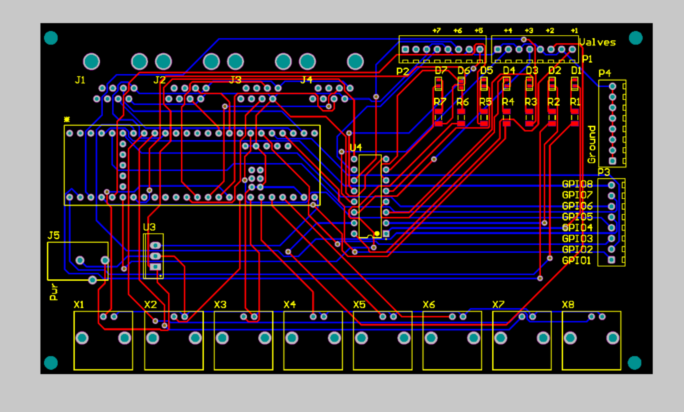
REV 2– PCB designed in circuitmaker.

